Slide 1
Lecture 22 another way to generate graphs two functions on those graphs tandem worklists

Slide 2
Mazes as generated graphs
(define M4
(list O O O O O
O W W W O
O W O O O
O W O W W
W W O O O))
(make-pos 0 0) has no field that holds a list of subs
BUT
(next-positions (make-pos 0 0)) generates (list (make-pos 0 1) (make-pos 1 0))

Slide 3
101
102
108
107
103
104
105
106

Slide 4
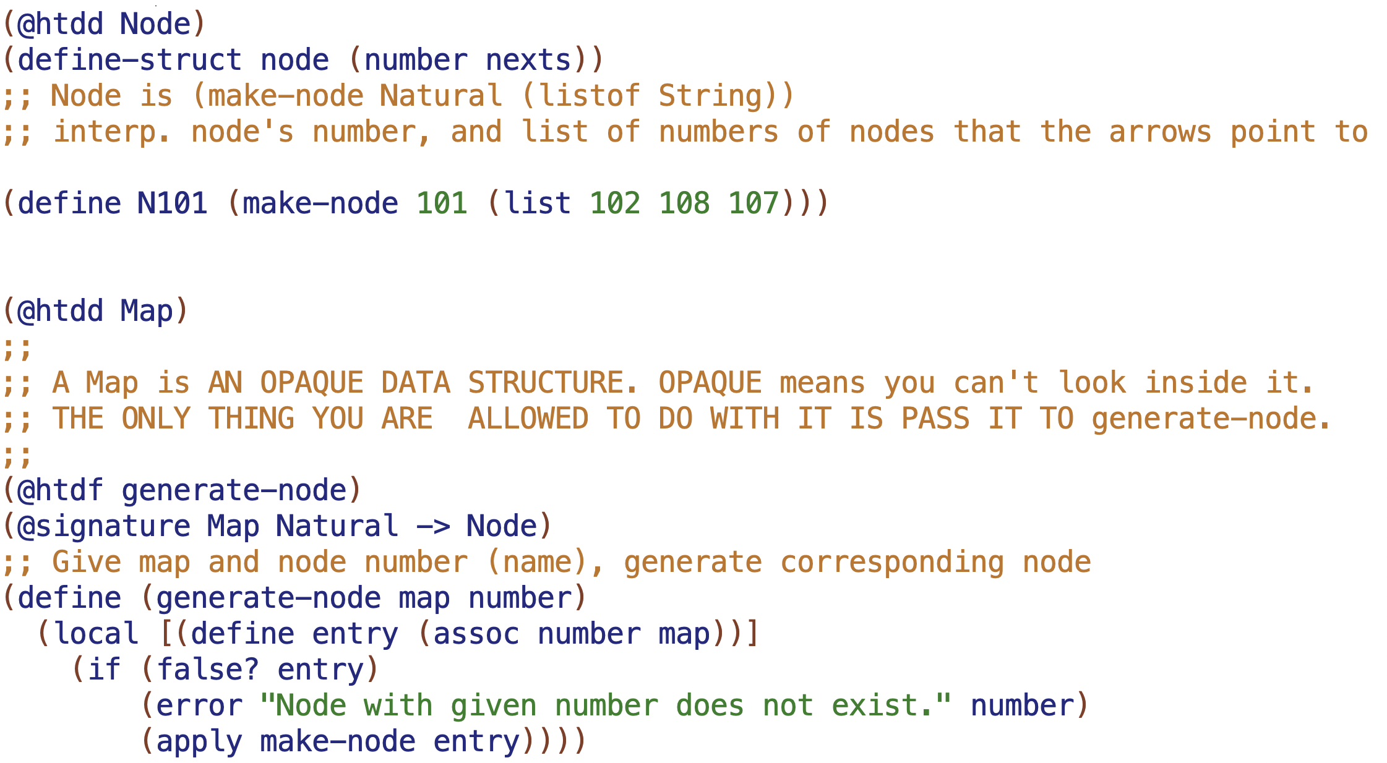
101
102
108
107
103
104
105
106

Slide 5
101
102
108
107
treat this as a primitive
103
(generate-node MAP 101) generates
(make-node 101 (list 102 108 107)))
104
105
106

Slide 6
1
provided MAP has 3 separate graphs in it
101
2
6
102
108
107
3
5
8
103
4
9
a graph can have cycles and joins, it doesn’t have to
104
105
106
11
12
15
16
13
14
17
18

Slide 7
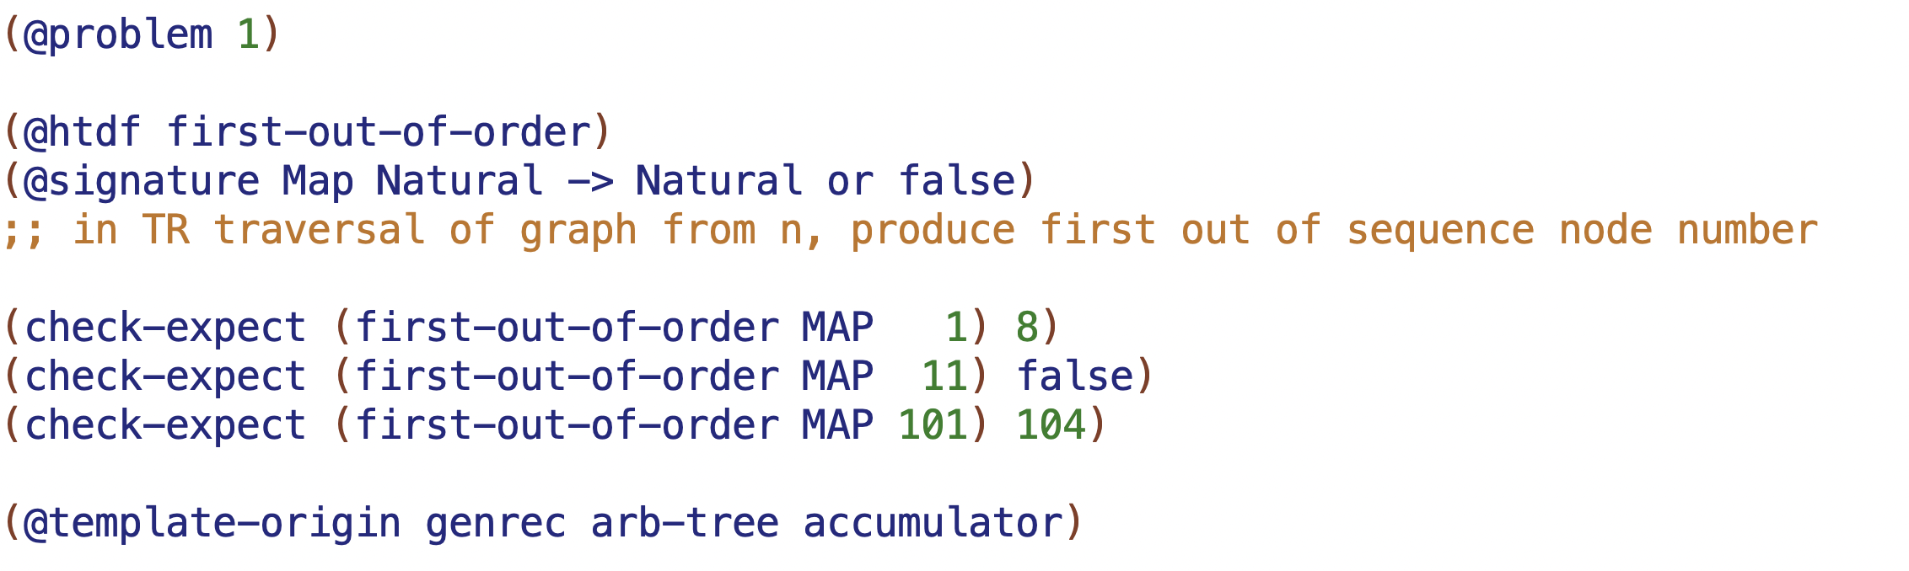
1
2
6
3
5
8
out of order
4
9

Slide 8
is one out of order? which one?
101
102
108
107
103
104
105
106

Slide 9
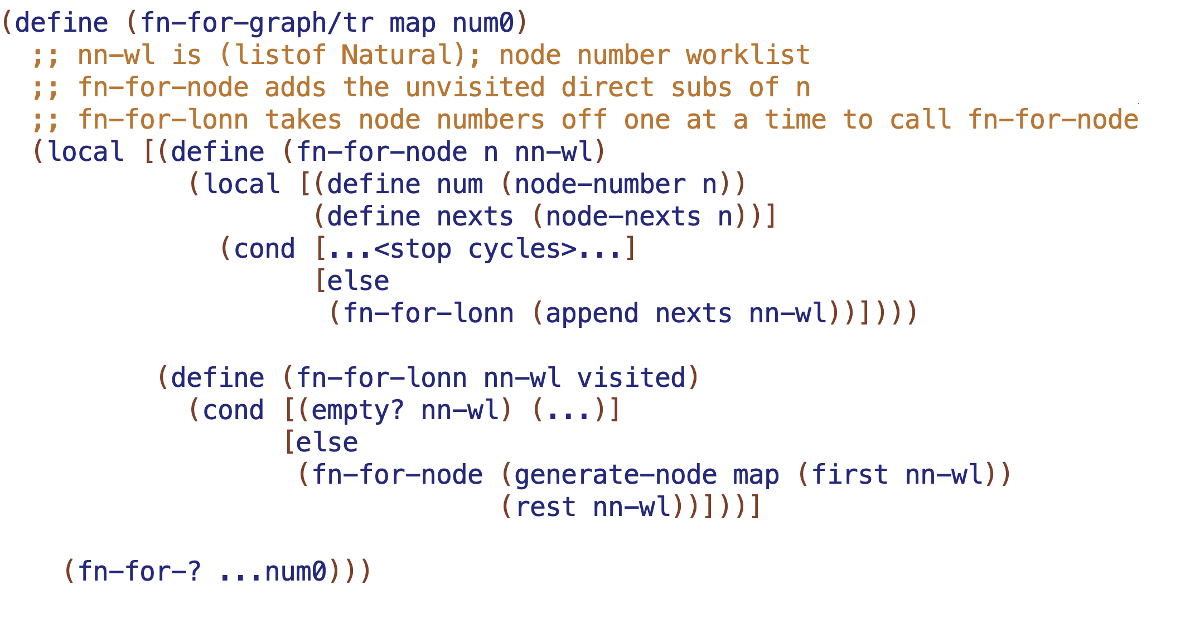

Slide 10
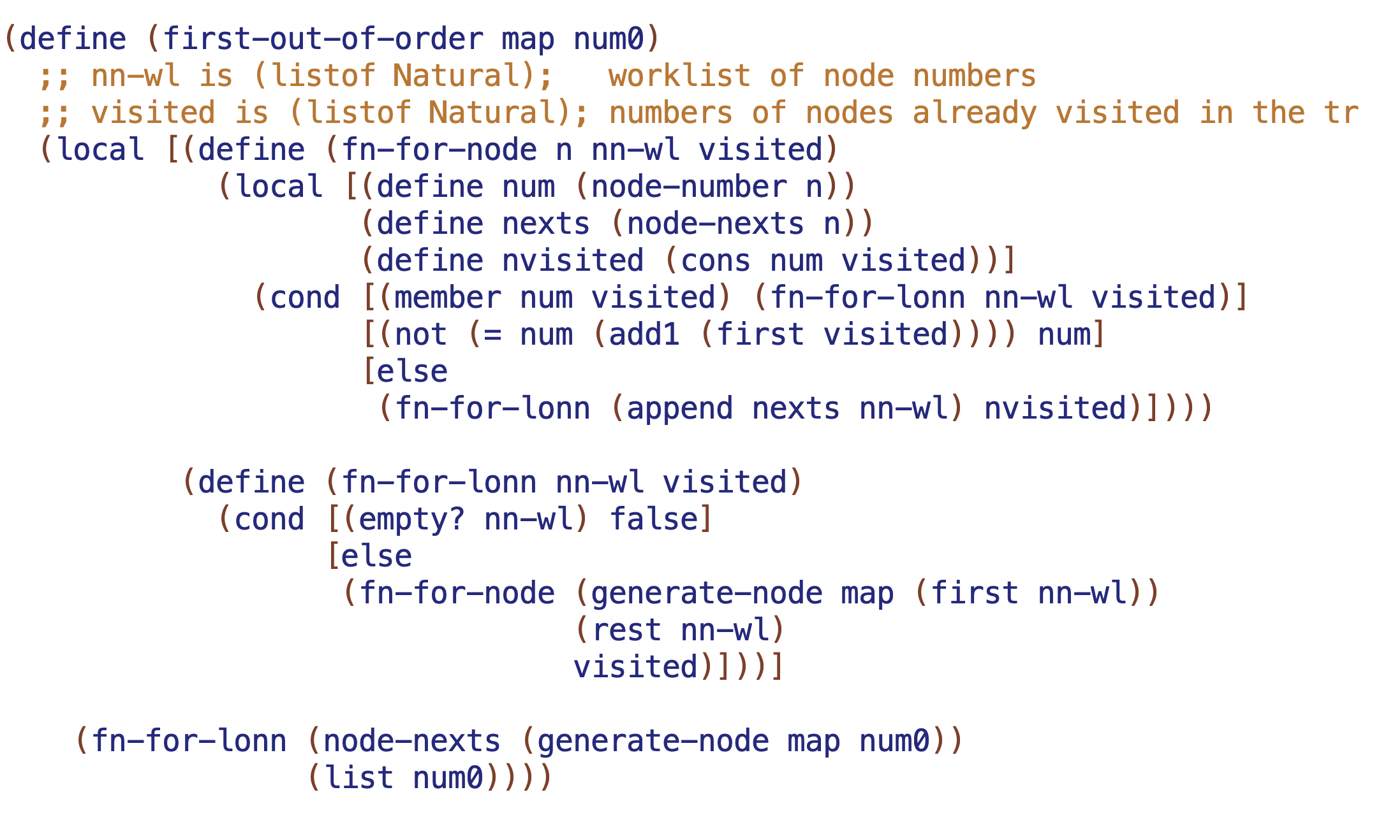

Slide 11
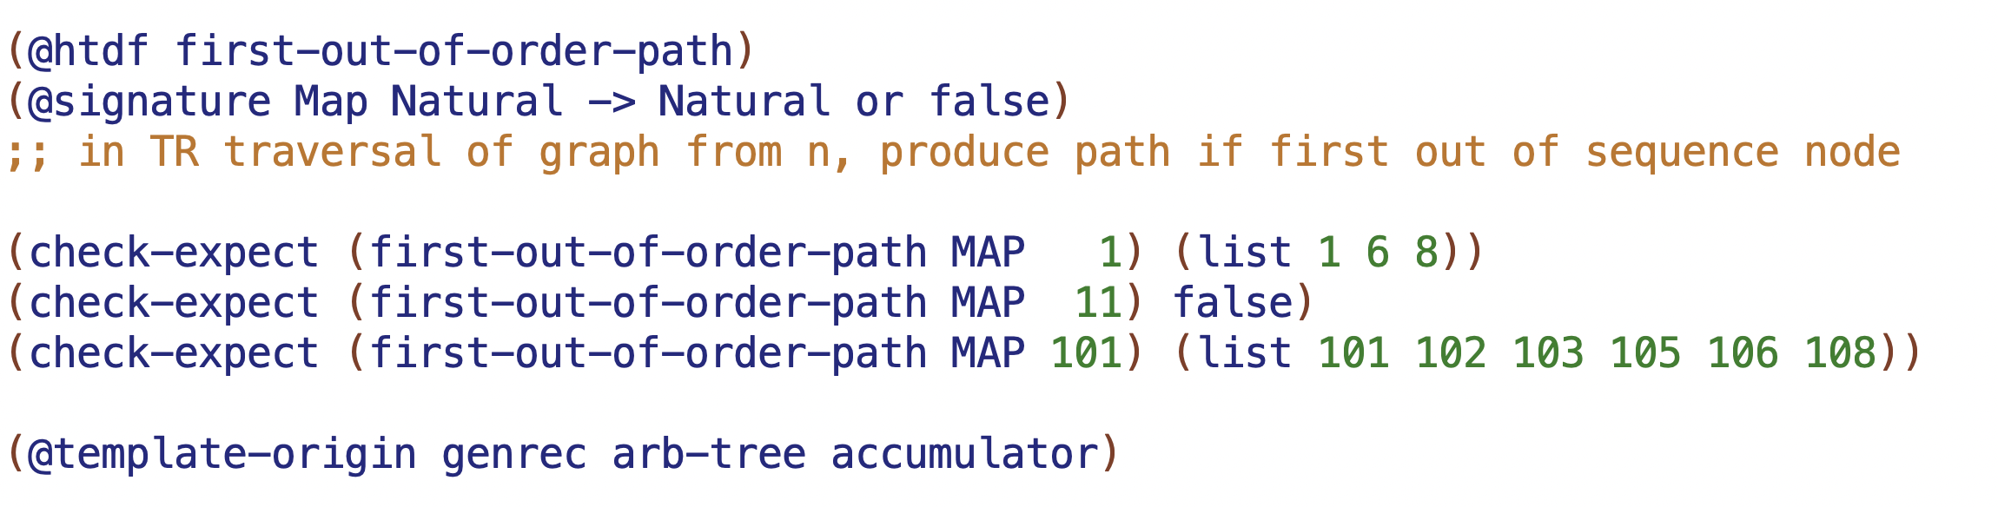
1
2
6
3
5
8
4
9

Slide 12
1
nn-wl: (2 6)
visited: (1)
2
6
nn-wl: (3 6)
visited: (2 1)
nn-wl: (6)
visited: (3 2 1)
3

Slide 13
1
nn-wl: (2 6) path-wl: ((1) (1)) visited: (1)
2
6
nn-wl: (3 6)
path-wl: ((2 1) (1)) visited: (2 1)
nn-wl: (6)
path-wl: ((2 1)) visited: (3 2 1)
3

Slide 14
1
nn-wl:
path-wl: visited:
2
6
3
5
8
4
9

Slide 15
101
102
108
107
103
104
105
106

Slide 17
